Slide 1

Detection of Diseased portion in Lung Images
Project -249
T . Sai Nanda Kumar 180030287
D . Surya Teja 180030496
E . Kamal 180030520
Guided by
DR .C . Karthikeyan

Slide 2
Motiviation
The main motive of this project is to build a accurate and best result giving model for Lung prediction purposes using Machine learning Algorithms
This will help in predicting and diagnosing the lung problems in a faster way
At present there is more need of software technology in health sector to give accurate and best results. Especially in CT scan, MRI scanning etc.

Slide 3
Objectives
Objective of this project is detection of diseased portion in lung images using image segmentation technique
Pre-proccess the data to apply a Machine learning Algorithms for prediction of damaged portion in Lung images.
Applying suitable Ml Algorithms for better prediction in diagnosing the lung related disease.
Differentiating the dameged portion from original Image.

Slide 4
Hypothesis
Taking a Lung image from CT Scan and performing a image segmentation to make a data in ML format
Applying various filters and edge techniques to convert the image into data frame ,for further analysing purpose of the lung diseases.
Applying Machine learning Algorithms like Decisiontree, Random forest, Linear model to predict the damaged portion in lung images.

Slide 5
Abstract
The recent developments of deep learning support the identification and classification of lung diseases in medical images. Hence, numerous work on the detection of lung disease using deep learning can be found in the literature. In this project by using various machine learning techniques we compare and choose the better technique that is suitable for diagnosing the lungs and predicting the status quo of the lungs that is whether it is infected with any disease or it is in a healthy manner ,by choosing the best suitable technique we display the picture that depicts the disease that it is affected. Also we show the comparison of various machine learning techniques accuracy levels for better understanding purpose.

Slide 6
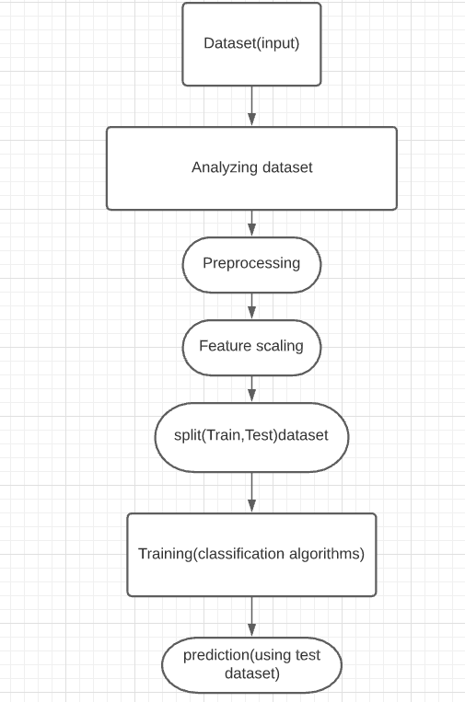
Picture depicting the modules of the project

Slide 7
MODULES
module:
Picture depiction
Applying filters and edge techniques
Applying Ml Techniques
Comparing various models and their accuracy
Creating prediction with the best Classification model

Slide 8
Literature Review:
Even after successful radical treatment of lung cancer, patients in stages I and II of the TNM system very frequently suffer recurrence, which end lethally. Detection of subclinical residual disease after surgery is thus one of the most important emerging diagnostic methods. Minimal residual disease (MRD) is defined as the presence of isolated tumor cells or circulating cells in a patient after curative primary tumor removal
The recent developments of deep learning support the identification and classification of lung diseases in medical images. Hence, numerous work on the detection of lung disease using deep learning can be found in the literature.

Slide 9
Problem survey
Due to the air pollution and other issues so many people are suffering from lung cancer, lung related diseases . It is important for health centers to provide accurate and best results in predicting the lung related diseases
To give a better results many Machine learning algorithms are need to classify or differentiate the data.
Image segmentation is one of the technique is to predict the given data using ML

Slide 10
Subject knowledge
Algorithms and techniques need for this project
Image segmentation using Edge-Based Segmentation:
Edge based methods partition an image based on rapid changes in intensity near edges. Edge filter is applied to the image, pixels are classified as edge or non-edge depending on the filter output, and pixels which are not separated by an edge are allocated to the same category.
Gabor filter
Canny edge detector
Sobel edge detector
Prewitt edge detector
Roberts edge detector
Gaussian edge detector

Slide 11
Subject knowledge
Gabor filter: It is a linear filter used for texture analysis, which essentially means that it analyzes whether there is any specific frequency content in the image in specific directions in a localized region around the point or region of analysis.
Canny edge detector: The Canny edge detector is an edge detection operator that uses a multi-stage algorithm to detect a wide range of edges in images.
Sobel edge detector: The Sobel operator is used in image processing and computer vision, particularly within edge detection algorithms where it creates an image emphasizing edges.

Slide 12
Subject knowledge
Prewitt edge detector: Prewitt operator is used for edge detection in an image. It detects two types of edges. I)Horizontal edges II)Vertical Edges.
Roberts edge detector: As a differential operator, the idea behind the Roberts cross operator is to approximate the gradient of an image through discrete differentiation which is achieved by computing the sum of the squares of the differences between diagonally adjacent pixels.

Slide 13

Picture depicting execution of project

Slide 14
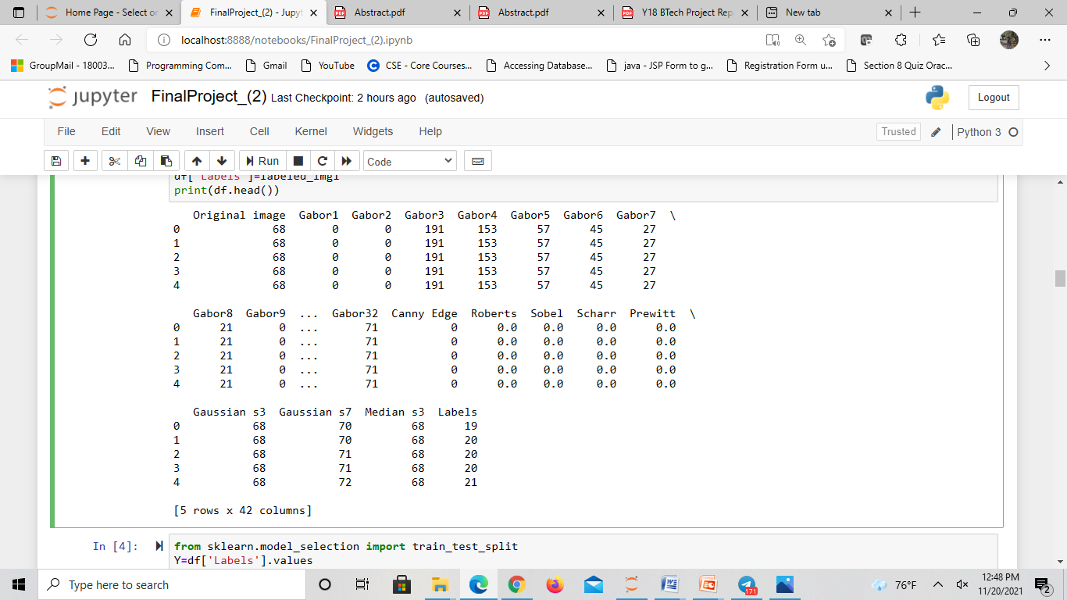
Dataset for the model

Slide 15
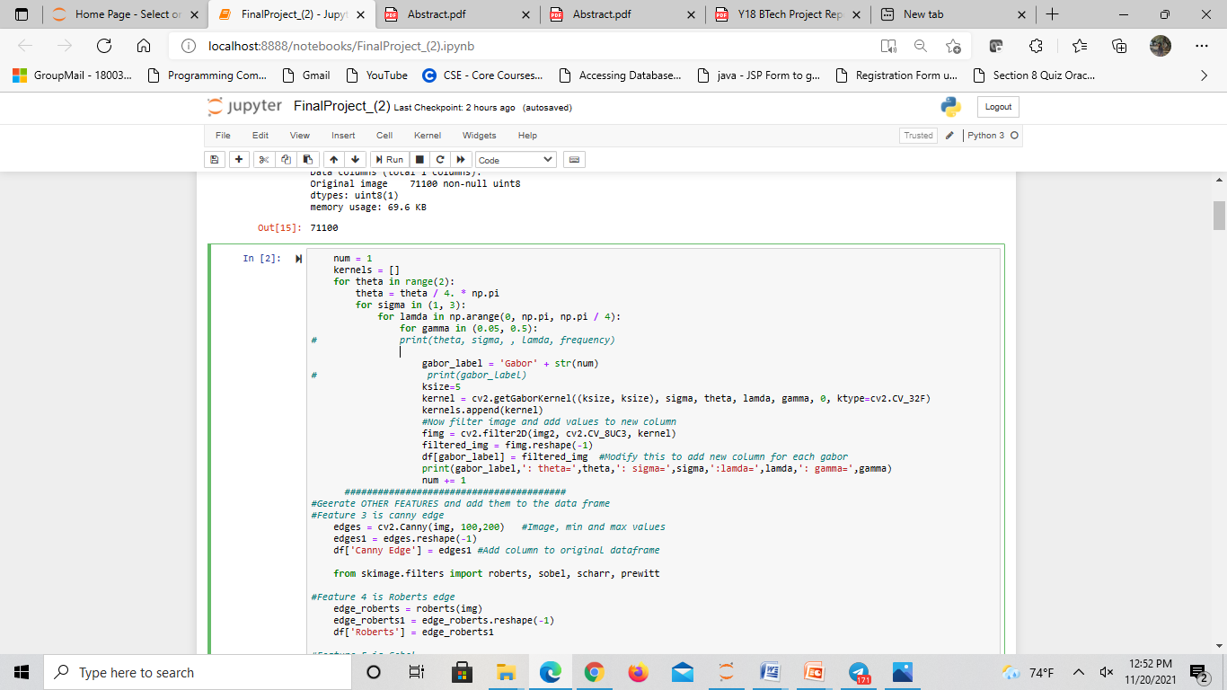
Applying filters and edge techniques

Slide 16
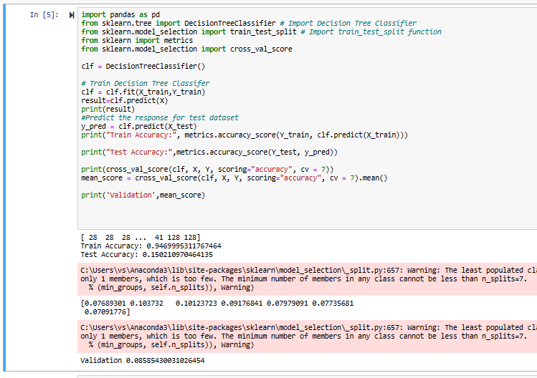
Applying ML Techniques: decision tree

Slide 17
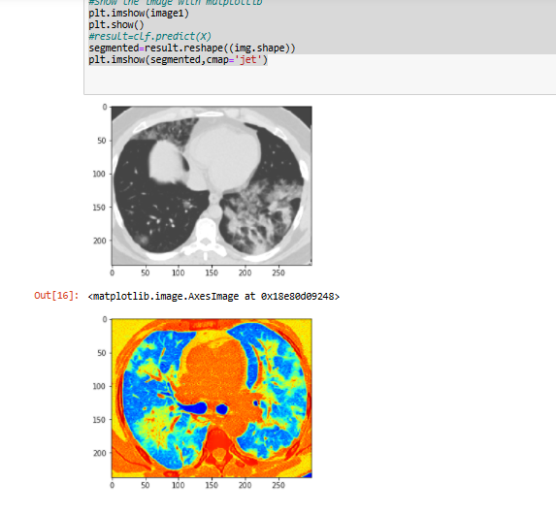
Output of Decision Tree Classifier

Slide 18
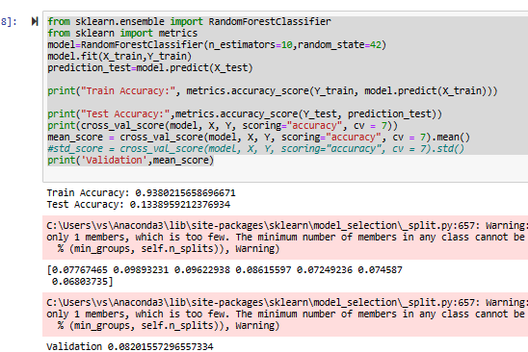
Applying ML Techniques: Random Forest

Slide 19
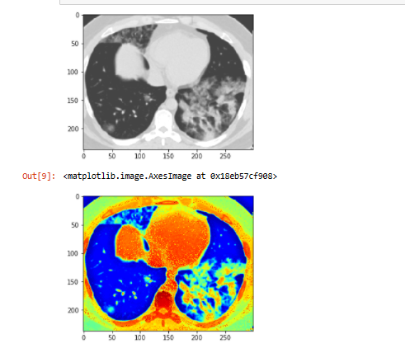
output of Random Forest

Slide 20
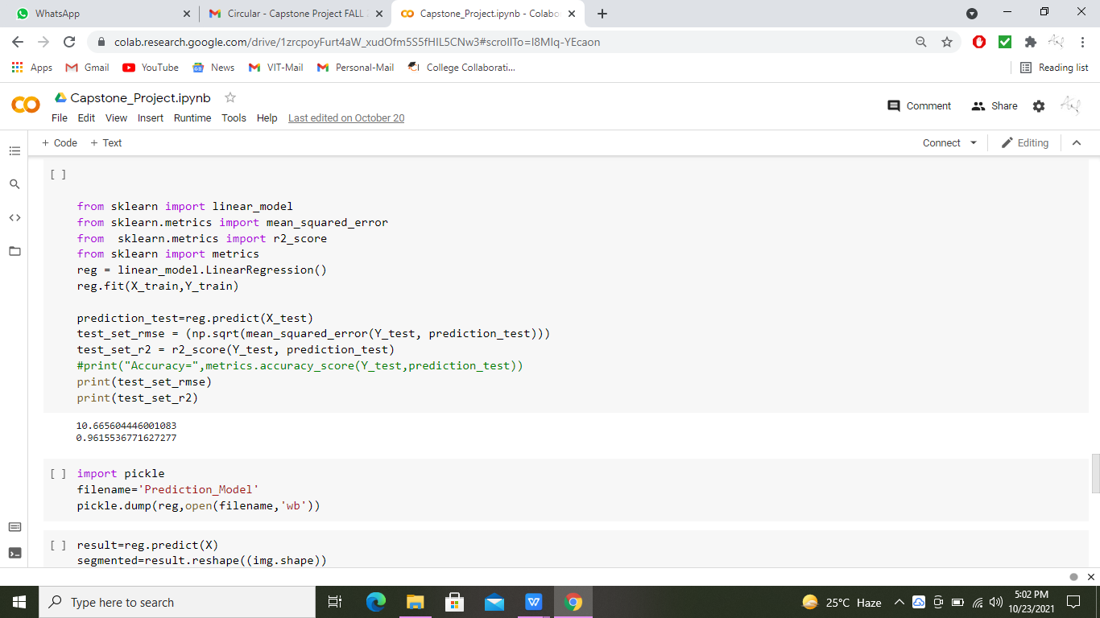
Applying ML Techniques: linear model

Slide 21
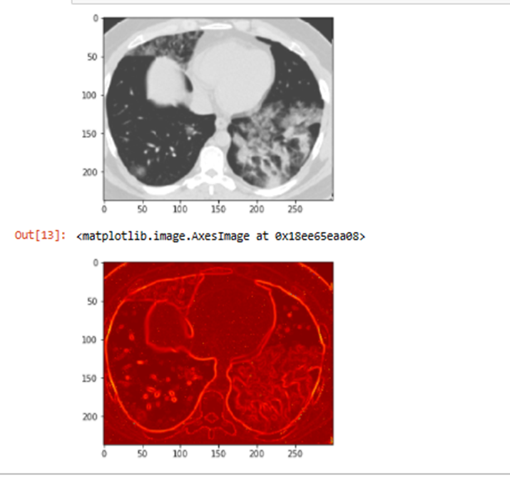
Test Case Output:-

Slide 22
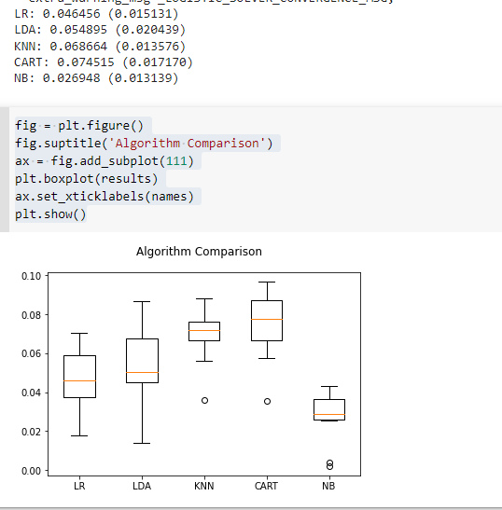
Box-plot image comparing various models and their accuracy values

Slide 23
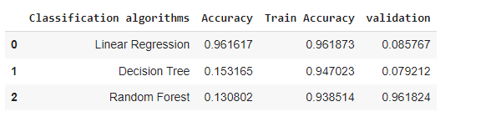
Data frame to check the best accuracy value of model.

Slide 24
Time Plan Green : completed
Modules | July – Sept 2021 | Sept 2021 | November 2021 | Nov 2021 | Nov 2021
Literature Survey
Problem identified
Data cleaning |  | done
Training
Analysis
Testing
Delivery

Slide 25
CONCLUSION
In recent times detecting the Lung Disease Using Software has enhanced in more larger Way Through Machine Learning Algorithms Which gives us the data in more understandable image segmentation format to analyses and predict by the image shown through the algorithms it will be easier to predict the type of disease that is having in the Lungs by showing the type of depicted color images displayed to show the diseased portion of Lungs .and also from comparison of various models for detection the linear regression model got the best accuracy value.

Slide 26
References
[1]. C. Clément-Duchêne, C. Carnin, F. Guillemin and Y. Martineta, "How Accurate Are Physicians in the Prediction of Patient Survival in Advanced Lung Cancer?", The Oncologist, vol. 15, pp. 782-789, 2010.
[2] Gunasinghe, A.D., Alphonso, A.C., Thirimanne, H.: Early prediction of lung diseases.Conference Paper, March 2019
[3]. Kuhlman, Dave. "A Python Book: Beginning Python, Advanced Python, and Python Exercises". Section 1.1. Archived from the original (PDF) on 23 June 2012
[4] Kadir, T., Gleeson, F.: Lung cancer prediction using machine learning and advanced imaging techniques (2018). https://doi.org/10.21037/tlcr.2018.05.15
[5]. NCI_SEER_Training_Lung_Cancer_Stats. Introduction to Lung Cancer: SEER training modules—National Cancer Institute; [2015]. Available from: http://training.seer.cancer.gov/lung/.

Slide 27
Thank You

